Slide 1
Classification of Water Wells in Tanzania
Phase 3 DataScience
Moringa School
Dennis Mwanzia

Slide 2
Introduction
Water scarcity and lack of access to clean water pose significant challenges in Tanzania. With a population of over 63 million people, the country is struggling to provide clean water to its residents.
Tanzania has numerous existing waterpoints, including wells and pumps, but many of them are in a state of disrepair or have failed completely. This situation further exacerbates the water crisis and hampers efforts to provide clean and safe water to the population.
The project's main objective is to develop a model classifier that can predict the condition of waterpoints.
This predictive capability can greatly improve maintenance operations and enable proactive measures to ensure a sustainable supply of clean and potable water to communities across Tanzania.

Slide 3
Objectives
1. Develop a classifier to classify the status of water wells in Tanzania
2. Develop recommendations based on the status of the functional water wells in Tanzania.

Slide 4
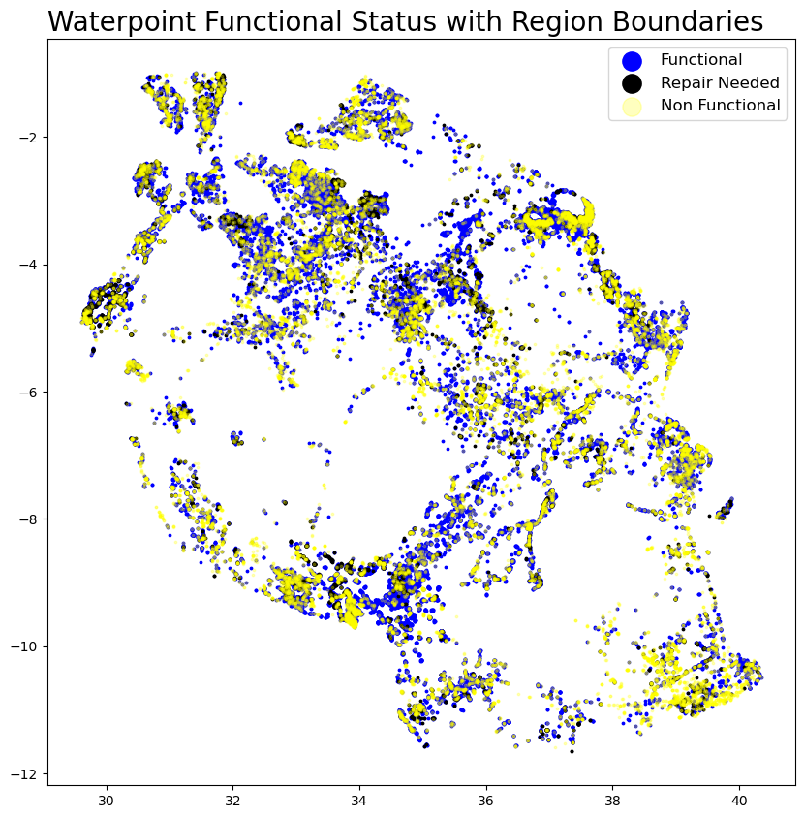
Mapping Waterpoints by Function
Most Wells are Functional
Followed by Non Functional

Slide 5
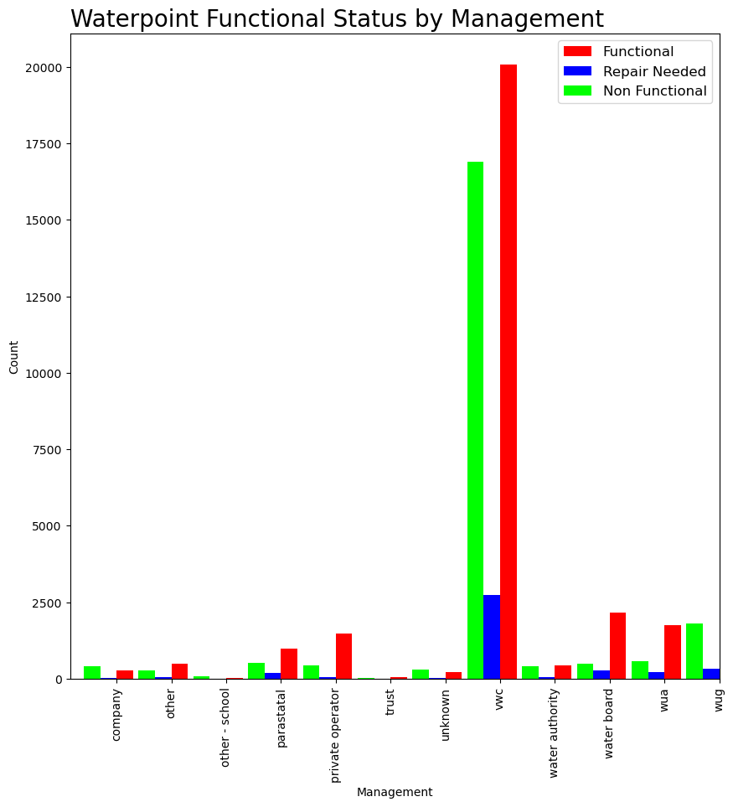
Waterpoints management by vwc had the highest number of functional, non functional and functional but need repair wells.
That management type also managed highest number of water wells.

Slide 6
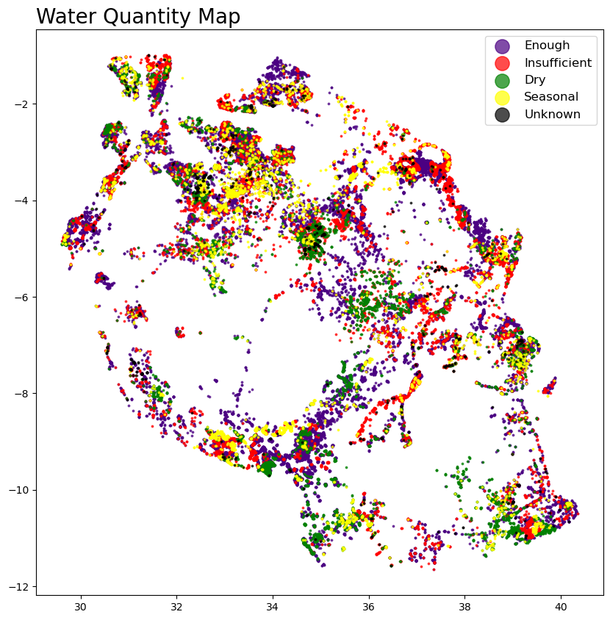
Most wells had enough water quantity

Slide 7
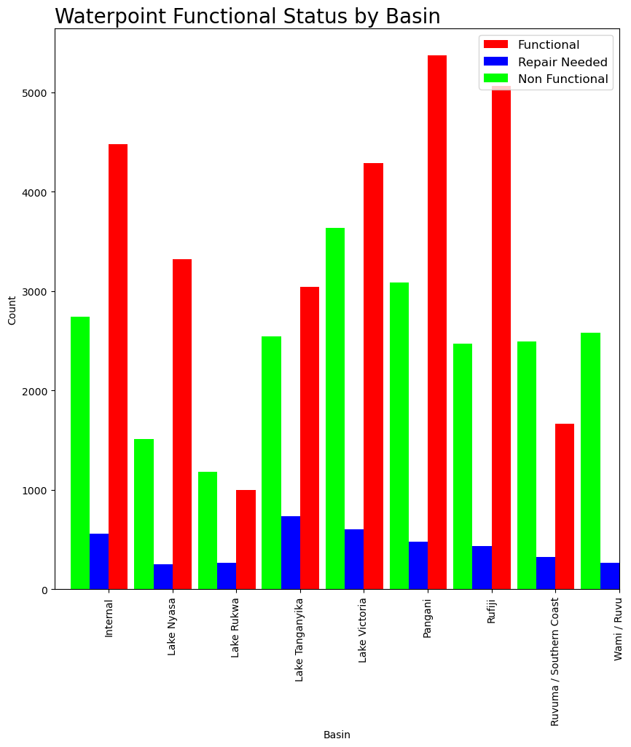
Waterpoint functional status by Basin

Slide 8
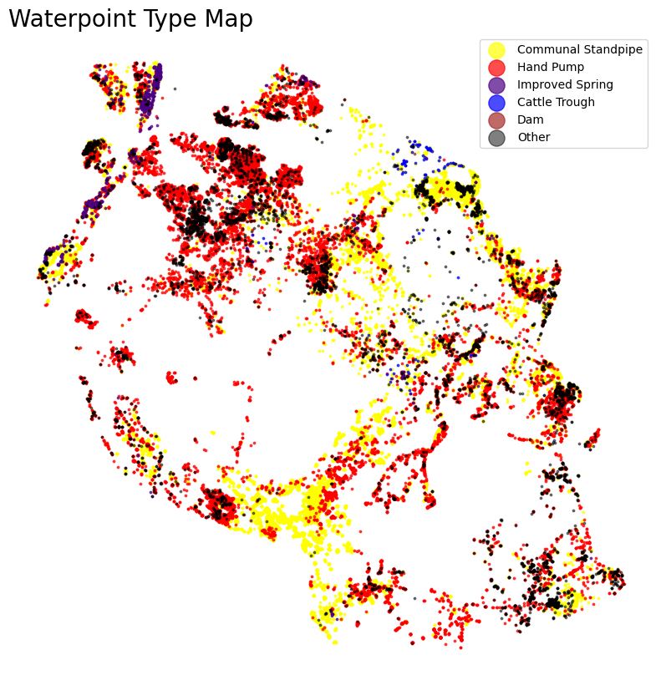
Communal standpipe are mostly distributed in southwest and eastern parts while handpumps are mostly in the north parts.

Slide 9
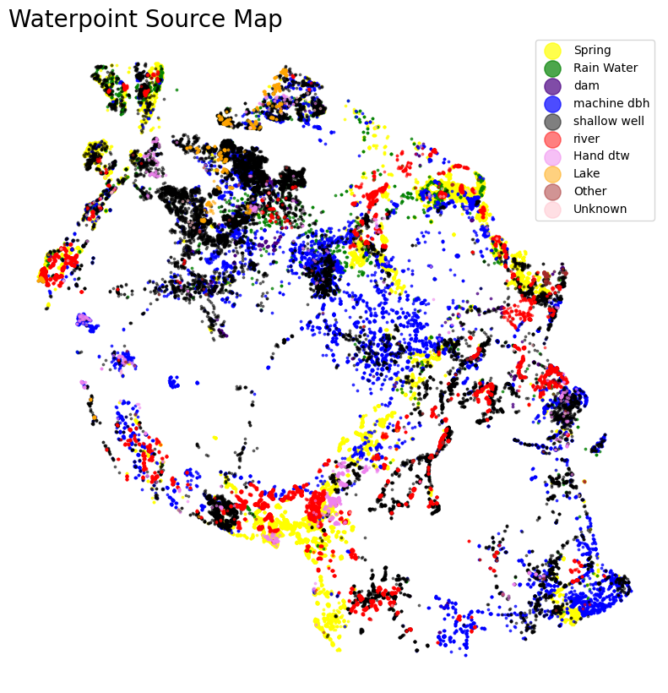

Slide 10
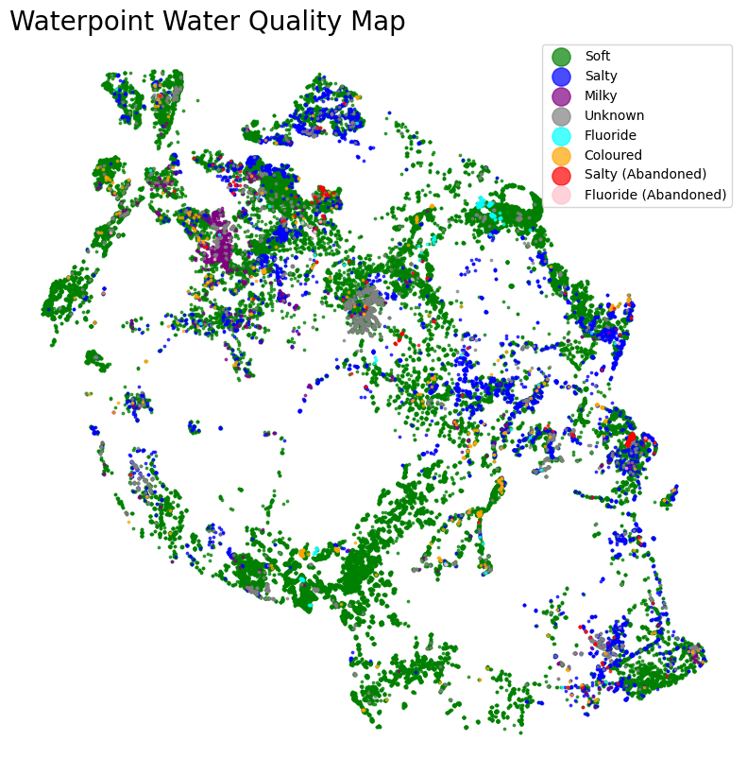

Slide 11
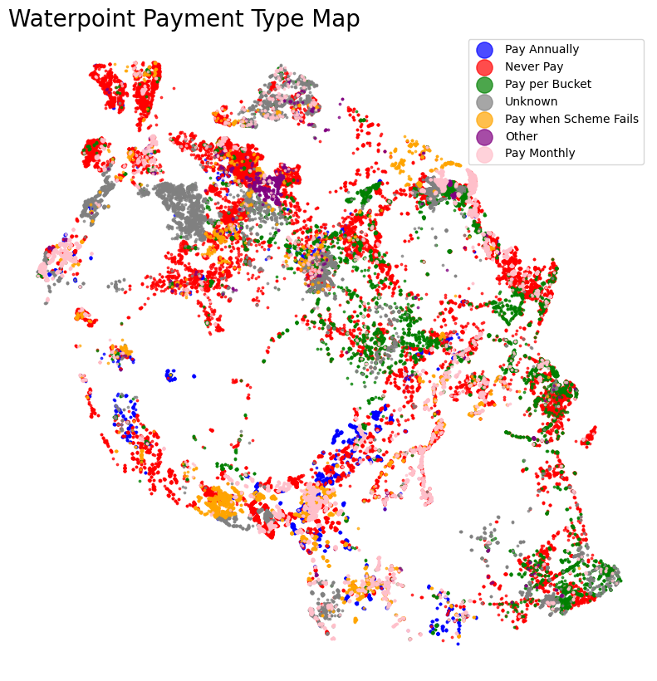
Waterpoint Payment Type Mapping

Slide 12
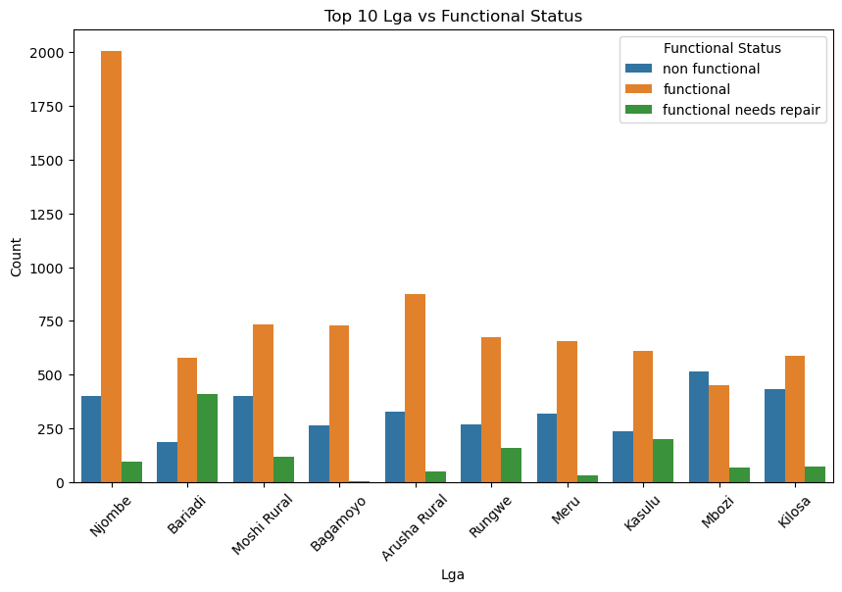

Slide 13
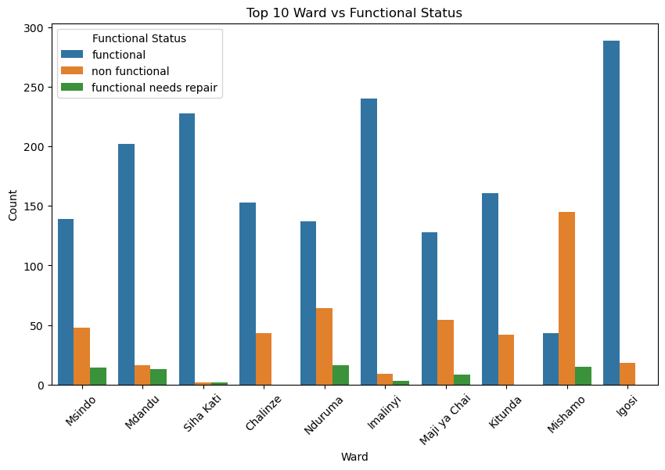

Slide 14
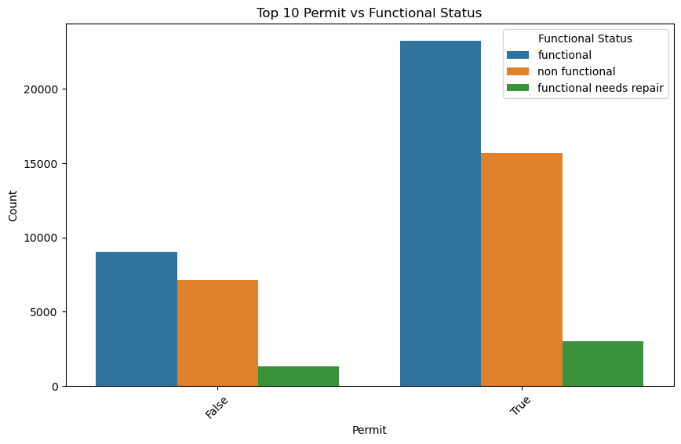

Slide 15
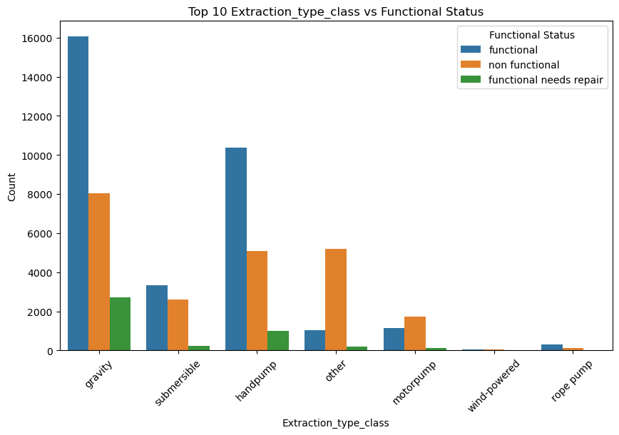

Slide 16
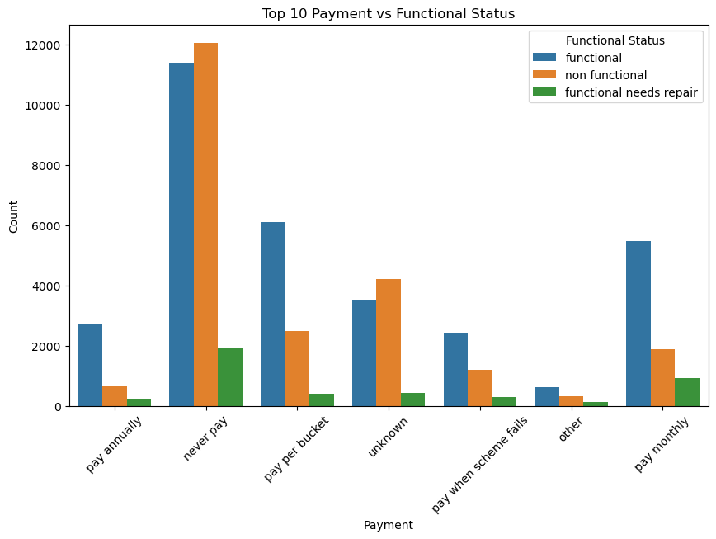

Slide 17
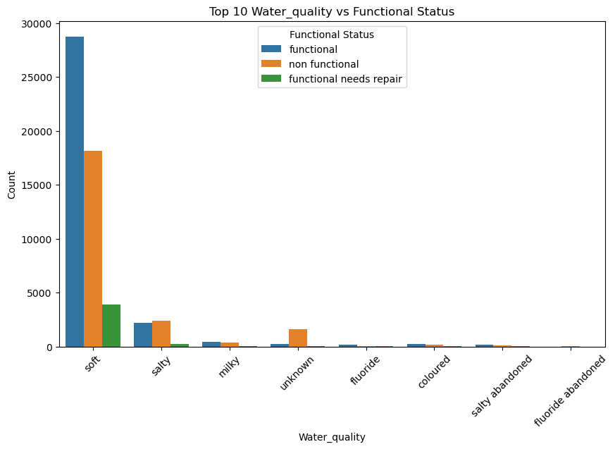

Slide 18
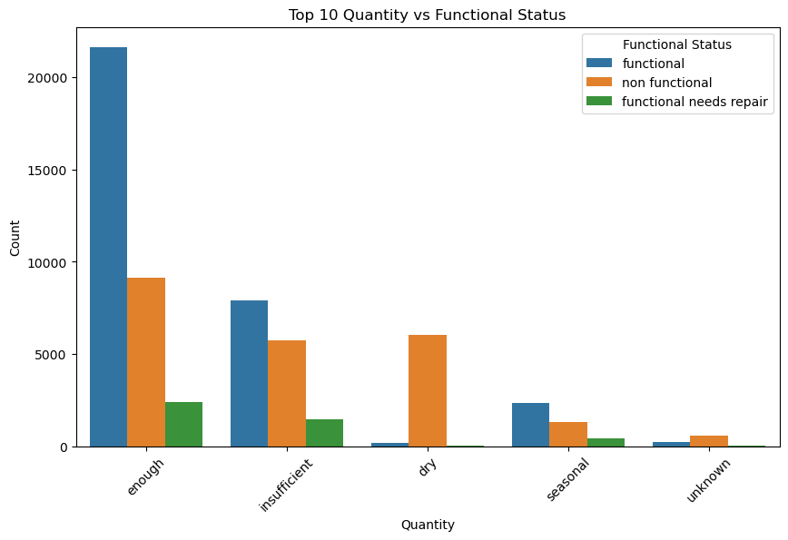

Slide 19
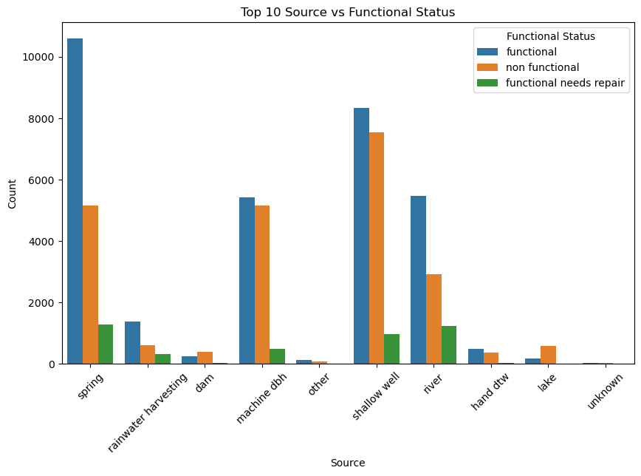

Slide 20
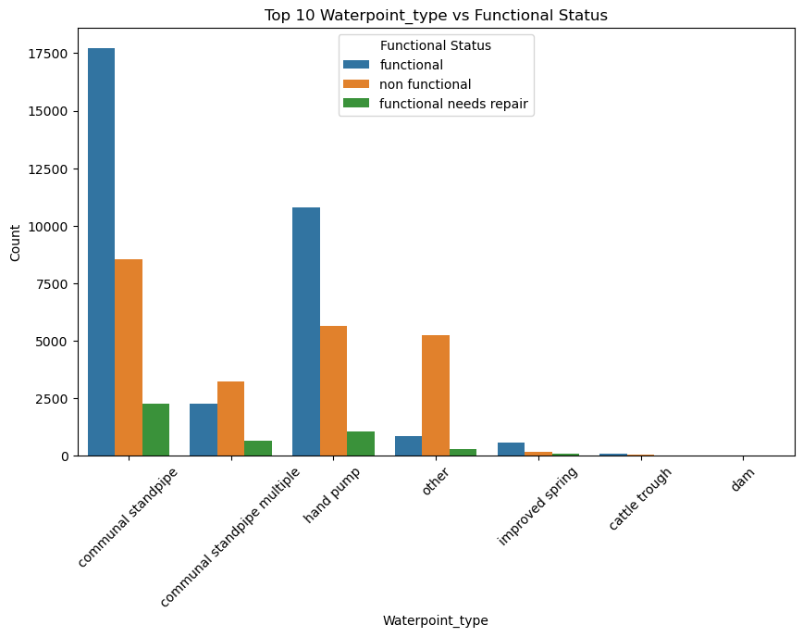

Slide 21
